Slide 1
HOME AUTOMATION USING PYTHON
Notes:
© Copyright PresentationGO.com – The free PowerPoint template library

Slide 2
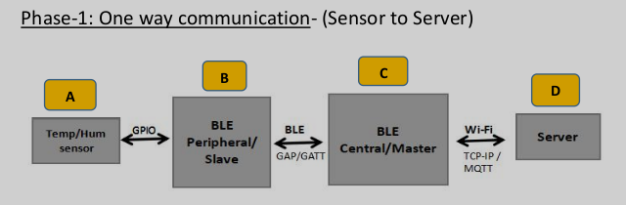
Overview of Project
1. Phase-1 : One Way Communication
2. Phase-2 : Server to Senor Communication
3. Phase-3: Adding Securities to Current Model
Notes:
© Copyright PresentationGO.com – The free PowerPoint template library

Slide 3
Overview
Implemented BLE simulator which sends the temperature and humidity data to the server
The projects implements a gateway using TCP/IP communication protocol
When the data exceeds the threshold limit it generates alert message
Notes:
© Copyright PresentationGO.com – The free PowerPoint template library

Slide 4
Working Flow
Module A :Continuously generating the values of the temperature and humidity using random module.
Module B(Slave): Collects the data continuously and make packet and advertise the packet every 10sec to Module C (master).If data detected by Module C is abnormal,It need to change frequency and start advertisement.
Module C(Master):Receives the advertisement packet data from the Module B (slave) check for the abnormality,if detects the abnormality sends message to increase the through put. If abnormal condition is reached ,send alert message and asks Module B(slave) to reset the packet .
Module D(Server):Receive the data from the Module C(master) and plots the Live graph and saving onto file.
Notes:
© Copyright PresentationGO.com – The free PowerPoint template library

Slide 5
Modules and Communication Protocol
Socket Communication (TCP/IP)
Python Modules : socket, threading, matplotlib,pandas, logging, config, multiprocess,sys.
Notes:
© Copyright PresentationGO.com – The free PowerPoint template library

Slide 6
Thank You
Notes:
© Copyright PresentationGO.com – The free PowerPoint template library

